Slide 1
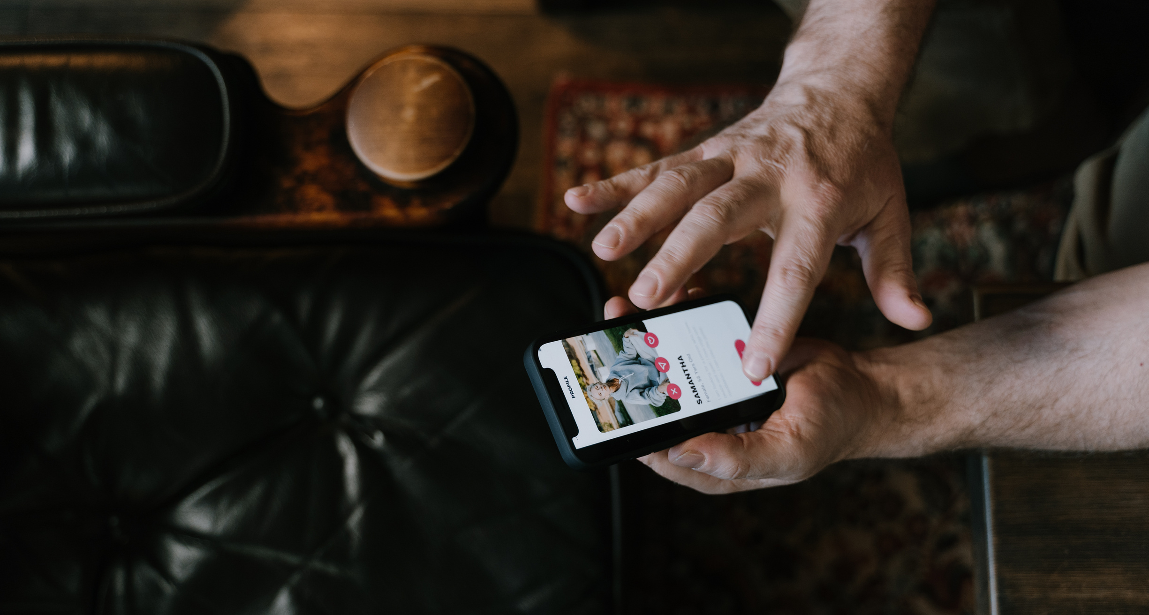
PITCH DECK
COVER
WARDIERE INC.
CRYPTO PITCH DECK PRESENTATION
A P2P CRYPTO EXCHANGE
Buy and sell digital currency directly from other users, instantly and without fees.
Presented by:
Date:
Sacha Dubois
January 2, 2025

